Slide 1
Portfolio Valuation
Insights from loan origination data

Slide 2
Introduction:
Welcome to the Portfolio Valuation Analysis presentation. In this analysis, we delve into a comprehensive evaluation of loan origination data, unraveling valuable insights that illuminate the financial landscape. Our exploration focuses on understanding repayment patterns, implementing key assumptions, and forecasting cash flows to derive a holistic portfolio valuation.

Slide 3
Dataset Overview:
The dataset contains loan information of various vintages. Each vintage represents a specific loan origination month, and it records the loan amount originated and subsequent monthly repayments observed over a time period of 20 months starting from 31 may 2019 to 31 December 2020.

Slide 4
Assumptions:
1. All cash flows are assumed to be paid back over a period of 30 months.
2. Let 𝑝𝑖 denote the expected repayment percentage as a share of the origination amount. For the portfolio valuation, assume that the expected repayment percentages are calculated as follows: For the origination month, 𝑖 = 1, the value is already known and fed in. The same holds true for the following month, 𝑖 = 2, except for the last vintage, December 2020, where 𝑝2 has not yet been observed. For this vintage, assume that the expected repayment percentage for 𝑖 = 2 will be twice the repayment of the first period (𝑝2 = 2𝑝1.for the December 2020 vintage). From the third month until the forecast horizon, 3 ≤ 𝑖 ≤ 30:
𝑝𝑖 = max( 𝑝2 ∗ ln (1 + (1 − (𝑖 − 1)/ 30) (1 − Σ 𝑝𝑗) ), 0) , 1 ≤ j ≤ i-1
3. Assume that the forecasted cash flows are discounted with an annual rate of 2.5%.

Slide 5
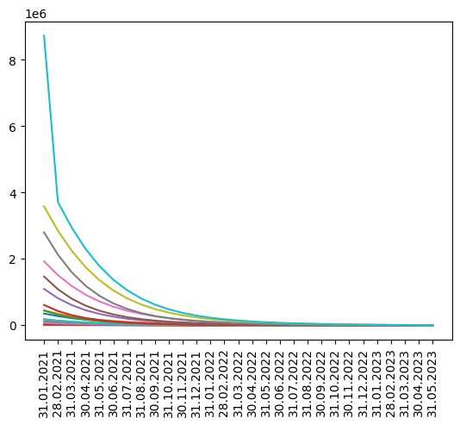
Cash flow over time:

Slide 6
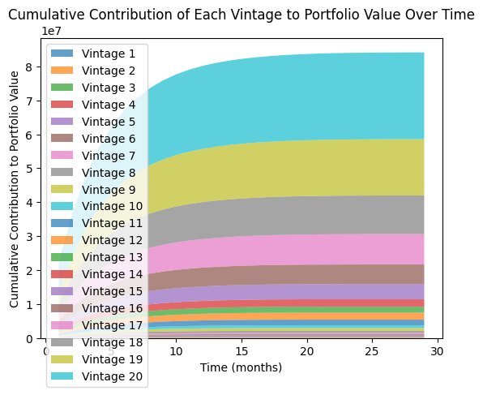

Slide 7
Conclusion:
In conclusion, our comprehensive analysis of the dataset has unraveled valuable insights into the repayment patterns of different vintages. The application of financial modeling techniques has allowed us to forecast cash flows and estimate the fair value of the portfolio, Which amounts to 84169372.82.

